Slide 1
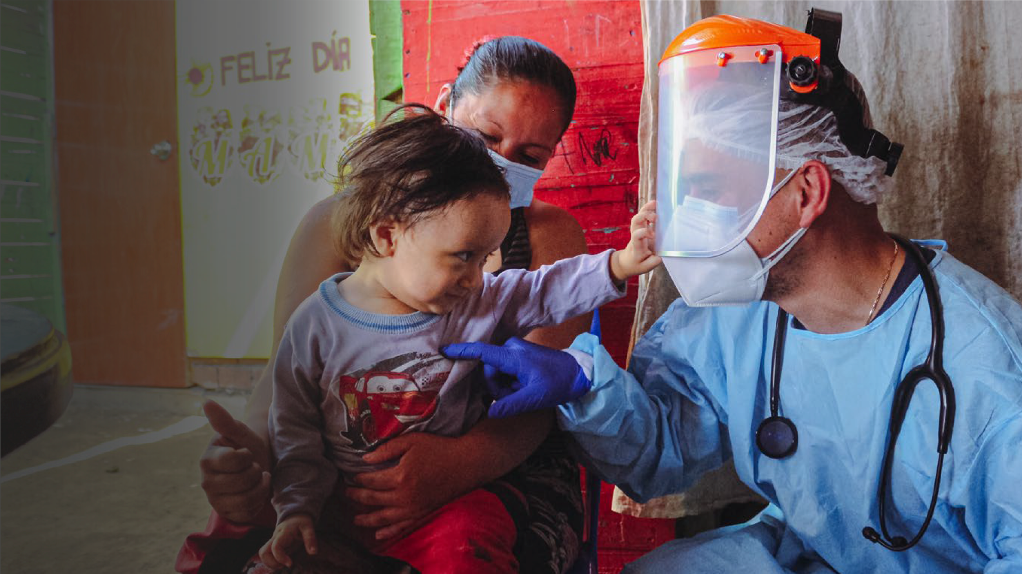


Slide 2

Seroprevalence of SARS-CoV-2 infection in Carabayllo, Lima Peru
Dr. Marco Tovar
Director Médico, Socios En Salud

Slide 3
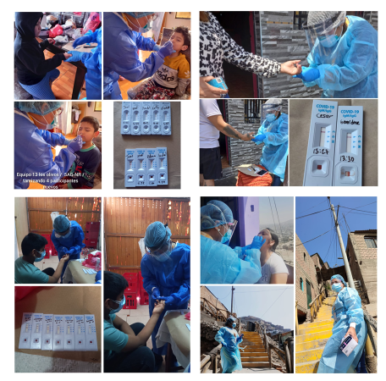
Introduction
Serological surveillance provides estimates of population-level immunity against infectious diseases using cross-sectional studies of antibody prevalence
In Perú, one surveillance in Lambayeque was done in June 2020 showed 29.5% of seroprevalence,[1] another one in Iquitos estimated a seroprevalence of 70% (IC 95%: 67-73) in July 2020 and 66% (95% IC: 62-70) at August 2020(12).[2] The largest seroprevalence study of SARS-CoV-2 in Lima showed 20.8% (95% IC: 17,2-23,5). [3]
To inform policy makers of DIRIS Lima North (dependence on MoH), we did cross-sectional, observational serosurvey study conducted between November and December 2020 in the district of Carabayllo to evaluate the seroprevalence of SARS-CoV-2 infection.
1. Diaz-Velez, C., et al., SARS-CoV-2 seroprevalence study in Lambayeque, Peru. June-July 2020. PeerJ, 2021. 9: p. e11210.
2. Alvarez-Antonio, C., et al., Seroprevalence of anti-SARS-CoV-2 antibodies in Iquitos, Peru in July and August, 2020: a population-based study. Lancet Glob Health, 2021. 9(7): p. e925-e931.
3. Reyes-Vega, M.F., et al., SARS-CoV-2 prevalence associated to low socioeconomic status and overcrowding in an LMIC megacity: A population-based seroepidemiological survey in Lima, Peru. EClinicalMedicine, 2021. 34: p. 100801.

Slide 4
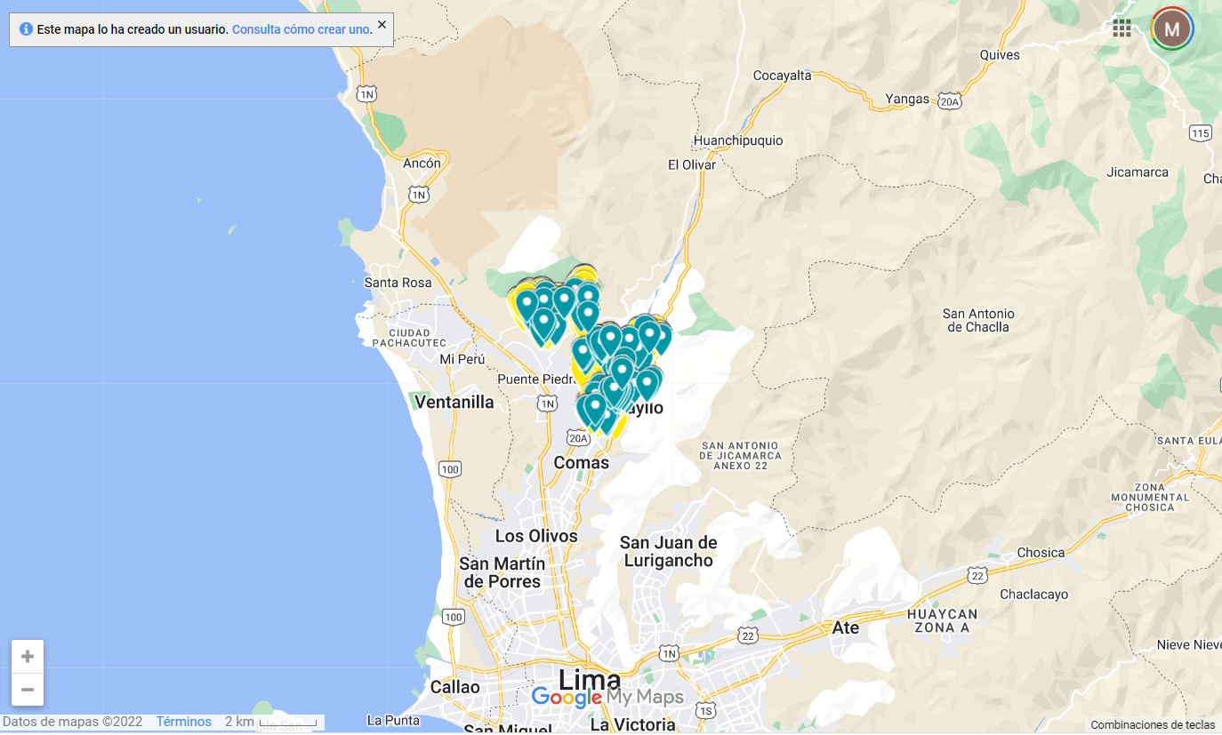
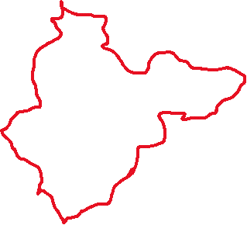

Methodology
The sampling scheme was designed to represent the entire Carabayllo population. The observational serosurvey study was conducted between November and December 2020.
SARS-CoV-2 IgM and IgG antibodies were tested using STANDARD Q COVID-19 IgM/IgG Duo Test by fingerpick as indicated by the manufacturer.

Slide 5
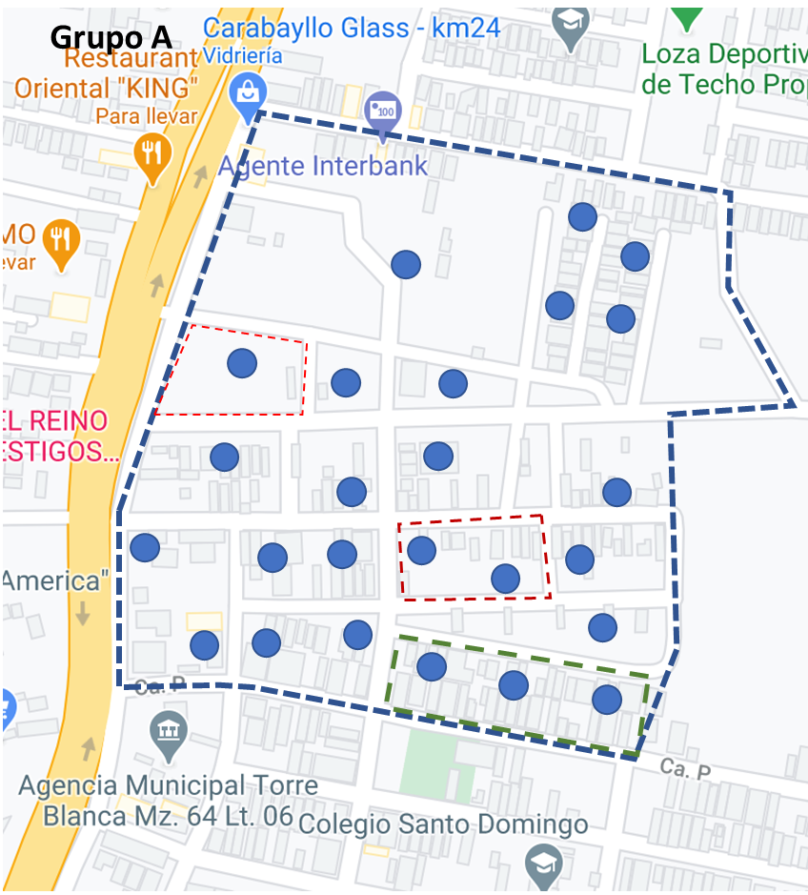
Methodology
We used Carabayllo maps from Google Maps Platform (reference: https://mapsplatform.google.com), using licensed ArcGIS Pro version 10.3 (reference: https://www.esri.com/en-us/arcgis/products/arcgis-pro/overview).
We defined equal-size clusters in the Carabayllo map, in each cluster we make sure that it has a minimum of 10 blocks and a maximum of 16 blocks of houses, for each block of houses up to three locations were manually selected using ArcGIS, obtaining up to 35 locations from each cluster

Slide 6
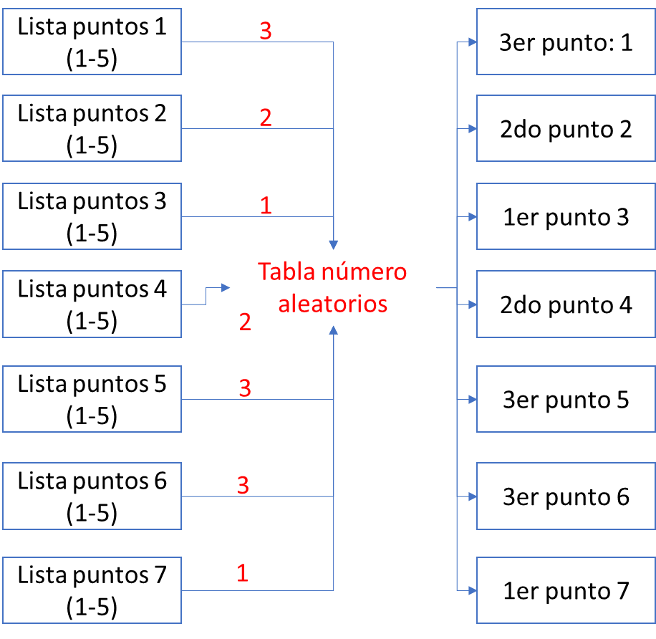
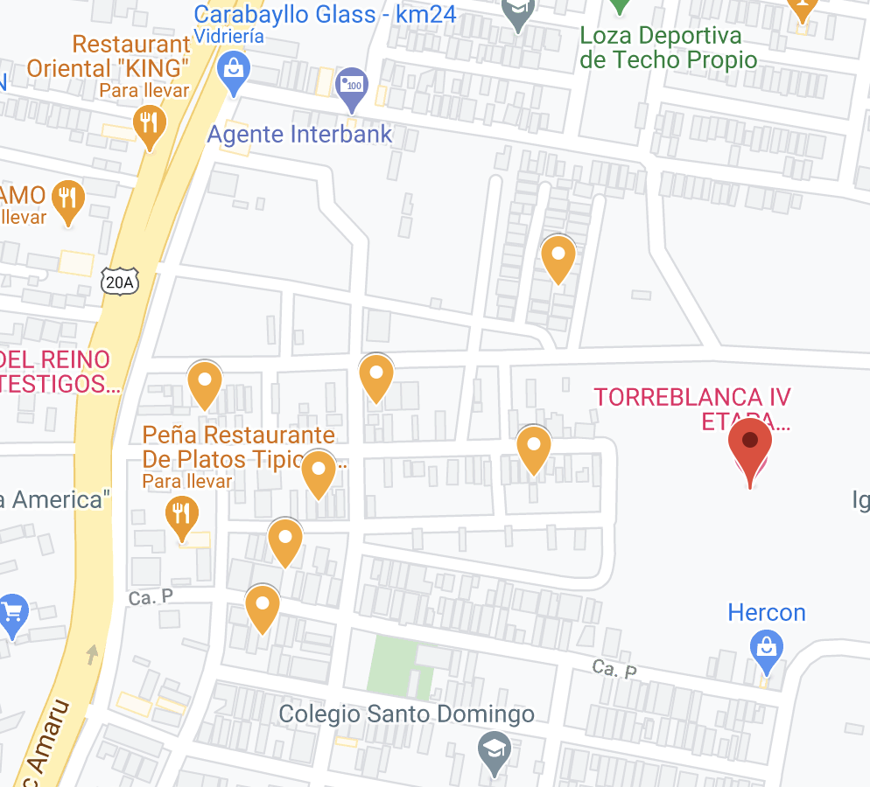
Methodology
A table of random numbers only 7 locations were selected of each cluster: 5 were to visit and 2 were backup in case any of the 5 locations is not possible to visit, the use of the 2 locations was in case it is not a dwelling, it is a dwelling but there are no inhabitants or there is one housing, inhabitants but do not want to be evaluated.

Slide 7
Methodology
We estimated the proportion of individuals who had a positive result for either IgG and/or IgM by calculating weights to ensure the age and sex distribution of the study participants matched the population of Carabayllo (Table 1).
To compare adjusted seropositivity across demographic and clinical characteristics, we estimated the prevalence ratio using generalized linear mixed models with a random intercept to account for household clustering.
We also provide overall seroprevalence estimates adjusted for imperfect accuracy of the antibody test using the method proposed by Diggle.[4] Specifically, we utilize the specificity estimate (95.1%) and sensitivity estimates based on date of symptom onset (68.9%-99.1%) reported in the STANDARD Q COVID-19 IgM/IgG Duo Test pamphlet. [5]
We performed all data analysis using the statistical software Stata version 15.0 (Stata Corp LP, College Station, Texas).
4. Diggle, P.J., Estimating Prevalence Using an Imperfect Test. Epidemiology Research International, 2011. 2011: p. 608719.
5. Avantika. SD Biosensor COVID-19 [Internet]. 2020. p. 1–2. Available from: www.sdbiosensor.com

Slide 8
Resultados
Table 1: Distribution of sex and age for the source and study population
Figure 1: Flow chart
Females were slightly overrepresented in the study population, but the age distributions within each gender are similar

Slide 9
Resultados
Table 2: Seroprevalence estimates by various sensitivity estimates from the STANDARD Q COVID-19 IgM/IgG Duo Test
Notes:
After weighting the study participants to match the age-sex distribution of Carabayllo, the seroprevalence of SARS-CoV-2 infection (presence of IgG and/or IgM antibodies) for the Carabayllo community in this period was 24.99% (22.51% - 27.72%).

Slide 10
Resultados
Table 3: The proportion of infected individuals stratified by sex and age

Slide 11
Resultados
Table 4: The proportion of individuals infected by SARS-CoV-2 stratified by presence of symptoms

Slide 12
Limitations
It is possible that some persons infected were not identified during the serosurvey due to delayed seroconversion due to a recent SARS-CoV-2 infection or seroreversion due to waning antibody response.
Nevertheless, our sampling scheme as opposed to convenience estimates decreases these issues.
Conclusions
The study shows that the proportion of people with evidence of infection in this population after the first wave is low compared to that reported in other studies.
At the same time, the results indicate that there is a large susceptible population that could be affected again, while there was no access to the vaccine that could be complemented maintained other infection control measures.

Slide 13

To submit Q&A questions, go to www.menti.com & enter code 5535 6338

